Slide 1
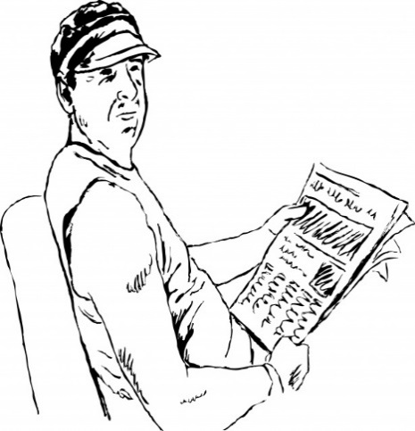
Qfl: Can I understand the difference between analysing language features and analysing structural features and the implications for the exam?
SMSC: Respect each other and allow others to learn.
BLP: Making Links
Communication: Reading
Starter: With a partner, explain what the difference is between a language feature and a structural feature.
Decide if the following are language or structure features:
Punctuation
Pathetic Fallacy
Ambiguous description.
Emphatic paragraph.

Slide 2
How confident do I feel about understanding he difference between language and structure for A02?

Slide 3
AO’s Assessed:
The Reading will assess A01, 2 and 4. AO1:
A01
Identify and interpret explicit and implicit information and ideas
Select and synthesise evidence from different texts
AO2:
Explain, comment on and analyse how writers use language and structure to achieve effects and influence readers, using relevant subject terminology to support their views
AO4:
Evaluate texts critically and support this with appropriate textual references

Slide 4
Simplicity and symmetry: each question will assess an individual AO
You will notice that Q2 and 3 both assess A02 but they are clearly looking for very specific points. Q2 is always about analysing Lang and Q 3 is always about analysing structure.
.
Slide 34
Copyright © AQA and its licensors. All rights reserved.
Notes:
This symmetry grid shows how each assessment focus develops progression through each paper.
Each question targets a specific reading Assessment Objective and that it follows a pattern of AO1, AO2, and AO3 or AO4 (where appropriate).
AO5 and AO6 for writing are covered equally in the Section B task on each paper.
Reading questions at the start of both papers assess AO1 and require students to demonstrate inference and information retrieval skills. Our assessment strategy then progresses to more demanding reading skills, such as AO2, AO3 and AO4.
Alongside this, is the requirement for students to progress from consideration of a section of text, to a response to the whole of the source.
Hence with Q1 on Paper 1, Q1 on Paper 2, and Q2 on Paper 2, we assess AO1 - in this way, we take the student on an assessment journey that starts with making a list, forming judgements about provided statements, and culminates in a summarising task.
Similarly, Q2 on Paper 1, Q3 on Paper 1, and Q3 on Paper 2 assess AO2, with students analysing language and structure – so that here they progress from a section of text, through to whole text, and from provided examples of language, through to a requirement for them to select their own material.
Q4 on Paper 1 assesses AO4 and requires a personal, critically evaluative answer in response to a statement about the text - this balances with Q4 Paper 2 which assesses AO3 and requires students to compare writers’ viewpoints/perspectives by reference to whole, or wider sections of both texts.

Slide 5
Q2 – language
How does the writer’s use of language…
Marks Given Max Time spend: Make approx:
8 marks 10 minutes 3-4 points
Comment, Explain, Analyse
This question assesses language – words/phrases / language features / language techniques / sentences
Use language terminology
Select relevant quotations
Explain and analyse the effects of the writer’s choices of language
A02- Use WETTER paragraphs.
AO2 Explain, comment on and analyse how writers use language and structure to achieve effects and influence readers, using relevant subject terminology to support their views

Slide 6
Q3 – structure
How does the structure…
Marks Given Max Time spend: Make approx:
8 marks 12 minutes 3-4 points
Comment, Explain, Analyse
This question assesses structural features:
Of the whole text like beginnings/endings: changes in viewpoint
At paragraph level such as topic change/single sentence paragraphs
At sentence level such as sentence length
Use language terminology
Select relevant references from the text
Explain & analyse the effects of the writer’s choice of structural features
AO2 Explain, comment on and analyse how writers use language and structure to achieve effects and influence readers, using relevant subject terminology to support their views

Slide 7
Features of Language and Structure:
https://www.bbc.co.uk/education/guides/zsf2v4j/video
Watch the BBC Bitesize video discussing features of language and structure. Then as a class take the test that features on this page.
Using the video to help you and what you may already know, make a list of the features of language and features of structure that are mentioned. Use the table on the next slide to organise your ideas.

Slide 8
Features of Language and Structure- A02
Language | Structure
Challenge Task: Now write a short summary explaining the difference between features of language and structure and discuss which question you would write about these features for in paper 1.

Slide 9
Categorising :Structure or Language?
Adjective connective rhythm
simile foreshadowing punctuation polysyndeton climax emotive language pathetic fallacy personification
paragraphs alliteration metaphor sentence structure flashback
Beginning/middle/end
Challenge Task: Can you put each of the se features into the correct category?

Slide 10
Structure | Language
Rhythm Foreshadowing Punctuation Climax Paragraphs Sentence structure Flashback Beginning/middle/end | Adjective Connective Simile Polysyndeton Emotive language Pathetic fallacy Personification Alliteration Metaphor
Answers!

Slide 11
Remember:A02 –The basics!
Language – deliberate use of words to achieve a specific effect.
Structure- analysing the way a text has been put together in a specific order / sequence to achieve effect.

Slide 12
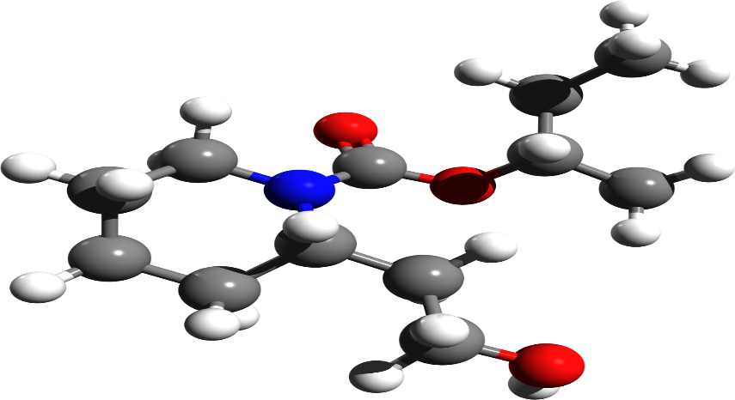
Aspects of structure we may discuss:
Perspective
Sequence of events
Beginnings and endings
The significance of the title
Punctuation and how it is used for effect.
The use of tense
The focus of attention in a specific section of text. Changes in focus.
Contrasts
Mood shifts
The use of sentence types for effect.
The use of paragraphs for emphasis or detail. For example, a single line paragraph to build tension or suspense or a detailed paragraph with several supporting sentences to add detail or description about a topic.
Passage of time
Location / settings.
Inductive narrative | Specific to general
Deductive narrative | General to specific

Slide 13
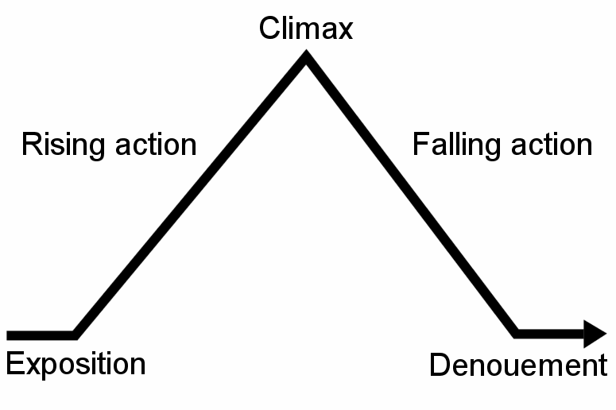
Freytag’s Pyramid.
Challenge Plus Task:
Can you pick two points about the writer’s use of language in the extract ‘The Whole Town is Sleeping’ and can you discuss two aspects of structure?
When discussing structure, we also discuss the typical story structure or arc.

Slide 14
Whole class feedback on the extract task:
Language
Structure

Slide 15
Any questions about the difference between language and structure?

Slide 16
Now how confident do I feel about understanding he difference between language and structure for A02?

