Slide 1
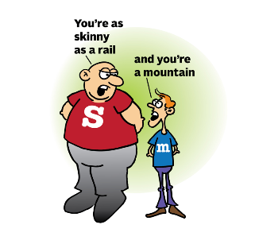
Toolkit for writing: paper 1
Content
Repetition
Senses
Moment in Time
Asyndetic Lists
Simile/Metaphor
Vocabulary
Contrasts
Curiosity/Ambiguity
Dialogue
3 Characters Max
Pathetic Fallacy
Structure
Varied length of sentences.
Third Person
Deductive Episode
Varied Paragraph Length
Past Tense
Change of Focus
Analepsis/Prolepsis
Emphatic/Single word Paragraphs
Inductive Episode

Slide 2
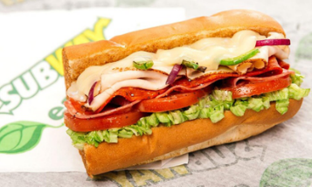
Toolkit for writing: paper 2
Content
Imperatives
Formal
Rhetorical Questions
Quotations
Anecdote
Emotive Language
Direct Address
Facts and Stats
Counter Arguments
Connectives
Structure
Address
Subheading
Conclusion
Vocabulary
Asyndetic Lists
Sentence Moods
Heading
Topic Sentences

